Slide 1
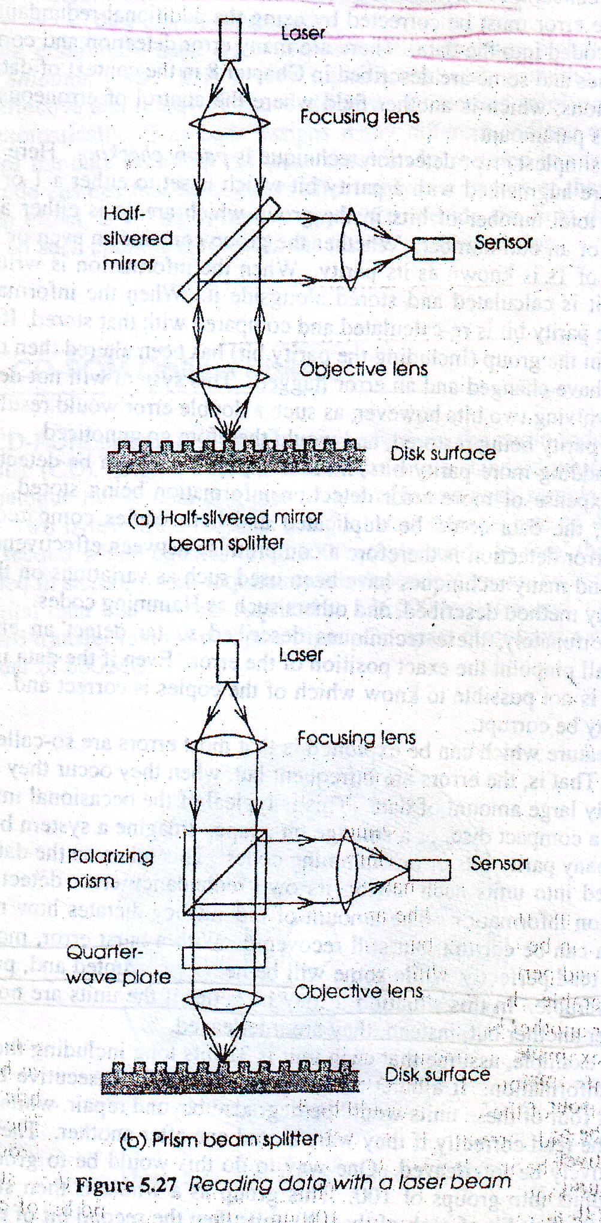
Optical Reading Mechanism

Slide 2
Optical Positioning
The beam must maintain focus to with the size of pits or beams on the surface
The beam should follow track precisely

Slide 3
Optical Positioning
There are two aspects to the positioning of the laser beam when reading data optically
Focus control
Track following
Focus control:
Focusing of laser beam on the surface depends on
the distance between objective lens and the surface

Slide 4
In order to provide the required depth of focus
Sensors must be arranged such that, one sensor is actually four separate sensors arranged in a diamond shape
A cylindrical lens is placed between beam splitter and sensor array
Alters the shape of the cylindrical laser beam
When in focus- appears as a circle on the sensor array
When out of focus- appears as elliptical image on the sensor array
The output of the top and bottom sensors is summed and compared with the output sum of the left and right sensors

Slide 5
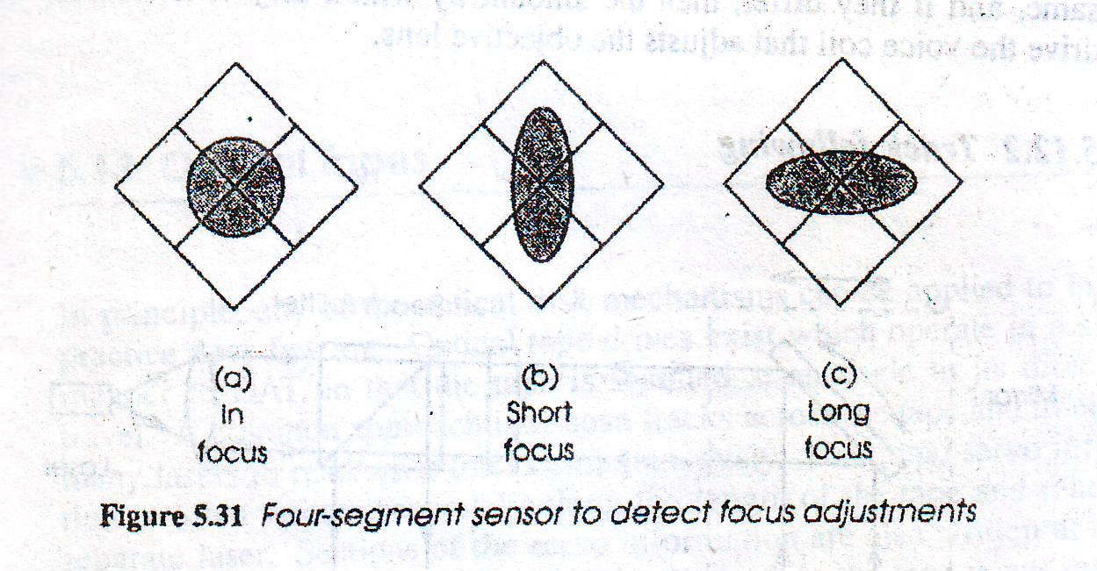
Focus control

Slide 6
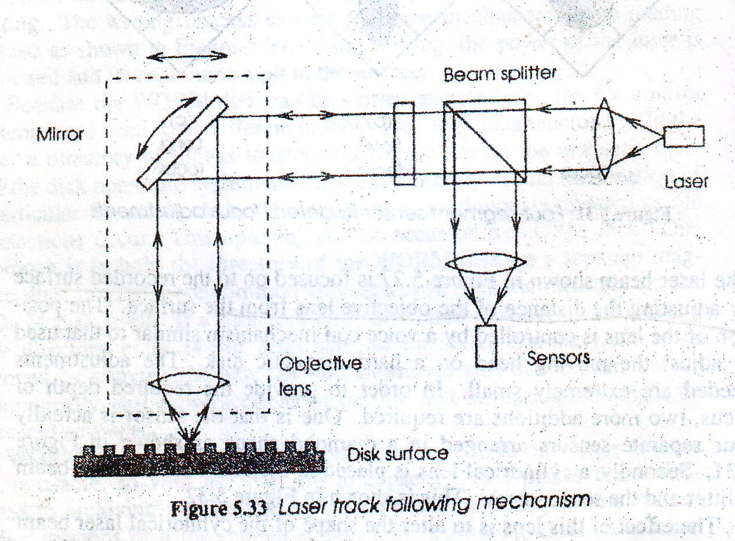
Track Following

Slide 7
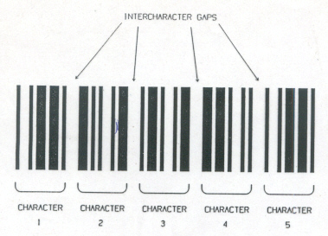
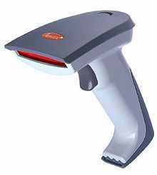
Bar Codes
Any situation in which a machine readable identification is required may make use of a suitable bar code
Barcode
handheld barcode scanner

Slide 8
Benefits of Bar Coding
Represent unique identity of a product
Aid effective management of resources and inventories
Labor savings by avoiding manual system
Cost efficient

Slide 9
Bar Code Scanners
barcode reader (or barcode scanner) is an electronic device for reading printed barcodes
Bar Code symbol consists of series of vertical dark bars separated by light spaces
When illuminated reflected light is detected by electro optical sensor
The intensity of reflected light from the dark bars is less than that of spaces

Slide 10
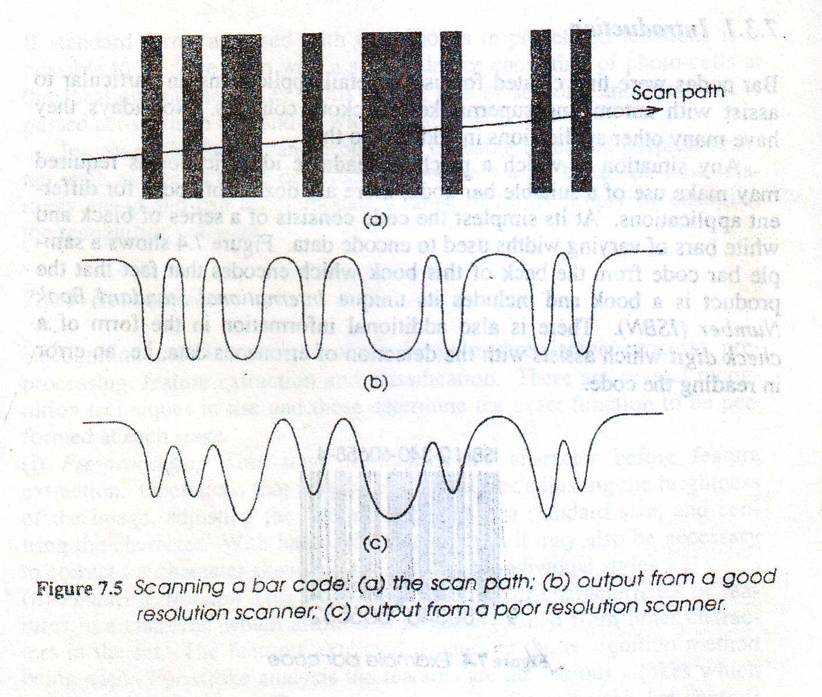

Slide 11
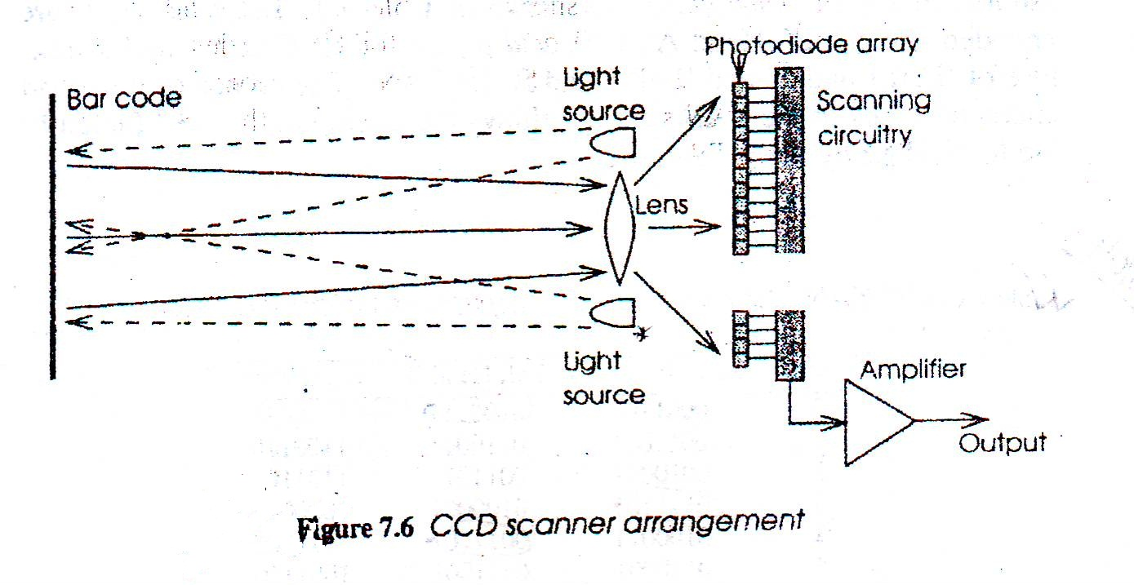
CCD(Charge Coupled Device) Scanner arrangement

Slide 12
Codes
UPC (Universal Product Coding)
Prefix – 1 digit
Manufacturer number- 5 digits
Item reference – 5 digits
Check digit – 1 digit
EAN (European Article Number)
Prefix – 2 digits
Manufacturer number- 5 digits
Item reference – 5 digits
Check digit – 1 digit
Checksum Calculation?
12 Digits
13 Digits

